Slide 1


Slide 2



Proceed with your
Login
Username
AIA001
Password
************
LOGIN
Sign up here

Slide 3




Back
Create your account
Sign up
Username
AIA001
Password
************
Confirm Password
************
SIGN UP
or sign up using

Slide 5





No records yet.
Home
Gallery
Stats
Settings

Slide 6


No images yet.
Home
Gallery
Stats
Settings

Slide 7

No data yet.
Home
Gallery
Stats
Settings

Slide 8



Account
Privacy & Security
Help and Support
About
Home
Gallery
Stats
Settings

Slide 9


Back
Account
Switch Account
Change Password
Logout
Home
Gallery
Stats
Settings

Slide 10

Back
Foodprint aims to increase awareness of health risk factors by providing warnings and precautions if your eating habits are taking an unpleasant turn. Through the use of computer vision in a wide variety of android phones, we can promote a Healthier, Longer, and Better Living and Lifestyle across broad audiences in different communities.
Learn more.
Developed by
Carpio | Go | Legaspi | Recto | San Juan
© 2022
Home
Gallery
Stats
Settings

Slide 11
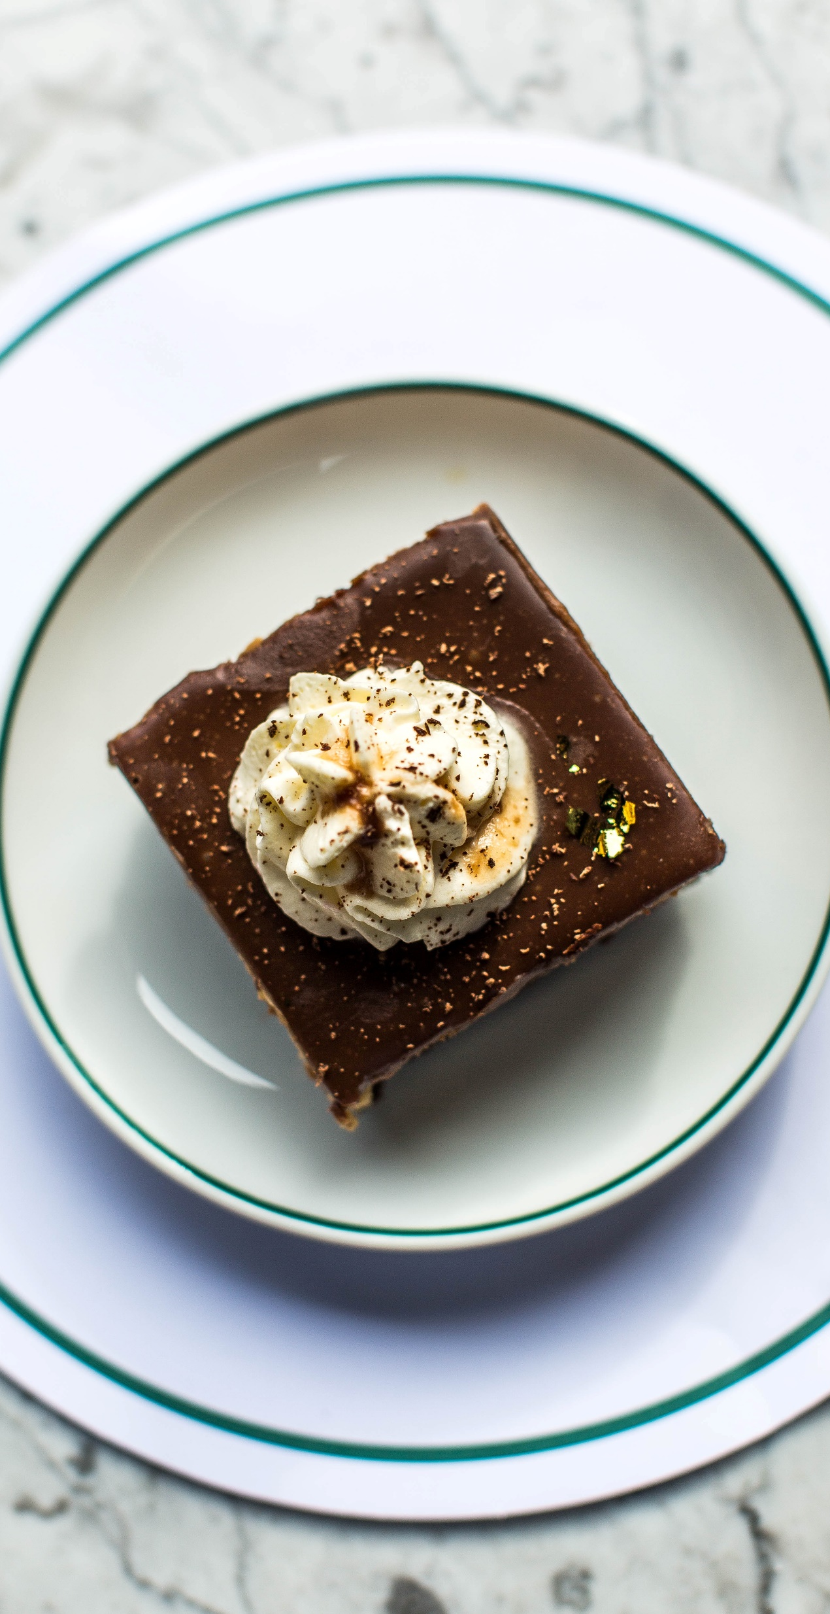



TAKE A SNAPSHOT

Slide 12




Retake
Ok
Cancel

Slide 13



PROCESSING IMAGE

Slide 14
98.02% Cake Detected
Cake
Brownies
Crepe
More
Retake
Cancel

Slide 15
98.02% Cake Detected
Cake
Brownies
Crepe
More
Retake
Cancel

Slide 16


est. size: 9”
Cake
Food-type
chocolate-coated or frosted
Serving size/quantity
Plate 9”, 1 slice 100g
Calories
452
Fat
25
Carbs
51
Total Sugar
26

Slide 17
Cake
4 / 11 / 2022
11 : 23 am
Home
Gallery
Stats
Settings

Slide 18
Cake
4 / 11 / 2022
11 : 23 am
Food-type
chocolate-coated or frosted
Serving size/quantity
Plate 9”, 1 slice 100g
Calories
452
Fat
25
Carbs
51
Total Sugar
26
Home
Gallery
Stats
Settings

Slide 19



Cake
Home
Gallery
Stats
Settings

Slide 20
Home
Gallery
Stats
Settings

Slide 21
Back
Cal
Sugar
Fat
Carbs
1000
900
800
700
600
500
400
300
200
100
0
day
123456789>
Home
Gallery
Stats
Settings

Slide 22
Back
Cal
Sugar
Fat
Carbs
100
90
80
70
60
50
40
30
20
10
0
day
123456789>
Home
Gallery
Stats
Settings

Slide 23
Back
Cal
Sugar
Fat
Carbs
100
90
80
70
60
50
40
30
20
10
0
day
123456789>
Home
Gallery
Stats
Settings

Slide 24
Back
Cal
Sugar
Fat
Carbs
100
90
80
70
60
50
40
30
20
10
0
day
123456789>
Home
Gallery
Stats
Settings

Slide 25
Account
Privacy & Security
Help and Support
About
Home
Gallery
Stats
Settings

Slide 26
Back
Account
Switch Account
Change Password
Logout
Home
Gallery
Stats
Settings

Slide 27
Back
Foodprint aims to increase awareness of health risk factors by providing warnings and precautions if your eating habits are taking an unpleasant turn. Through the use of computer vision in a wide variety of android phones, we can promote a Healthier, Longer, and Better Living and Lifestyle across broad audiences in different communities.
Learn more.
Developed by
Carpio | Go | Legaspi | Recto | San Juan
© 2022
Home
Gallery
Stats
Settings

